Slide 1

LCMHL
Coach-Manager MEETING
October 14, 2025
Google Meet

Slide 2

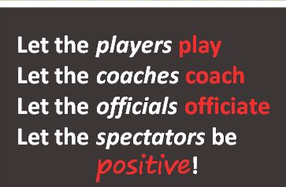
President’s Message
Welcome to the 2025-2026 LCMHL Season
Thank you, Tom!
Year of observing and learning
Thank you to all volunteers
Goals for this year
  Development (coaches and players)
  Respect
  Enjoyment

Slide 3

Meeting Agenda
Presidents Message
League Information/Important Dates
Responsibilities
Affiliations
D4 RIC – Brendon Stitt
Game switch/reschedule
Games
D4 Chair – Amanda Waterfield (maybe)
Tournaments
Escalation Process
GameCentral
Reference Links/Contacts

Slide 4

🏒 League Responsibilities
4
Administration of the League
Maintenance of the LCMHL Handbook
Scheduling of all house-level games (1,2,3)
Rules & Regulations around games
  e.g., game length, statistics, running clock, etc.
League-Level Discipline oversight
Team Placement in accordance with Hockey Eastern Ontario (HEO) Guidelines

Slide 5
Teams – By age group
Tier | 2025-2026 | 2024-2025
U9 | 45 | 39
U11 | 25 | 25
U13 | 23 | 25
U15 | 23 | 21
U18 | 28 | 32
U21 | 8 | 7

Slide 6
🏒 2025-2026 League Executive
6
President | Mike Taylor
Past President | Tom Stephens
Secretary | Jennifer Garner
Treasurer | Fiona Livingston
Webmaster | Brad MacDonald
Statisticians
U09 | Shawna Kealey
U11 | Jordan Heavens
U13 | Jane Cameron
U15 | Marie Côté
U18 | Debbie Heuchert
U21 | Debbie Heuchert
Notes:
Hike-ert

Slide 7
🏒 League Executive
Association Presidents
7
Almonte Pakenham | Scott Robillard
Carleton Place | Stuart Robinson
Osgoode Rideau | Cameron Legault
Perth Lanark | Morgan McNevin
Richmond Munster | Jim Wallace
Stittsville | Terry Foley
West Carleton | Chris Havey
Notes:
Hay-Vee

Slide 8

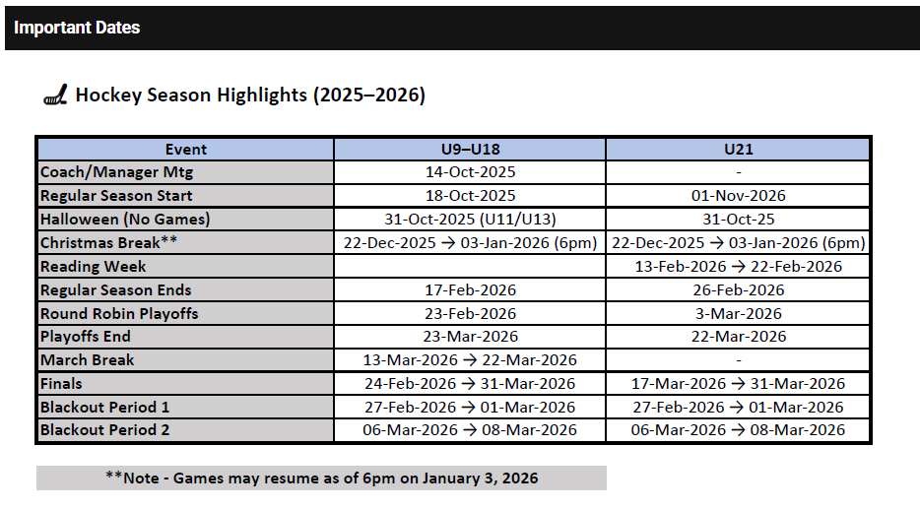
🏒 Important Dates for 2025-2026
8
Link: Important Dates (Lanark Carleton Minor Hockey League) (lcmhl.ca)

Slide 9
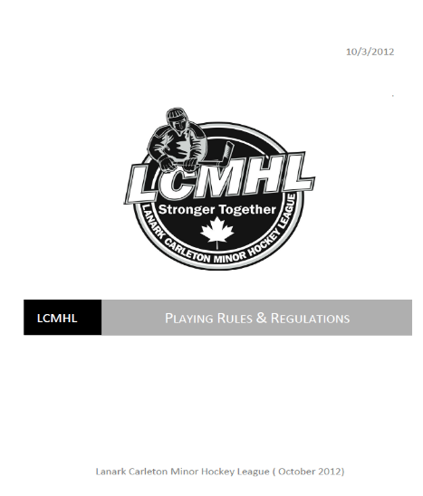
📘 LCMHL Handbook
One central source of information:
  LCMHL Constitution
  By-Laws
  Most importantly – Rules & Regulations
Read the rules in their entirety, especially:
  Game precedence and playoff structure
  The escalation process
  Game rescheduling procedures

Slide 10
Responsibilities of the Team Coach – Thank you
Oversee all team activities (practices & games)
Responsible for
  Report suspendable offenses to TTM
  e.g., 10-min misconducts, 5-min majors
  Submit game results within 48 hrs (24 hrs playoffs)
Ensure clear communication
Supervise players & staff
Maintain compliance & safety
Support player development
Track affiliated players
Many other duties
Most importantly — uphold team & parent conduct to league standards

Slide 11
Example responsibilities of the Team Manager
Thank you
Primary contact for parents, players coaches and association
Responsible for game switches/reschedules
Team budget and reporting
Fundraising and team events
Tournament booking and management
Tracking affiliated players (with coach)
Roster and forms
Together with the coach, assistant coaches, trainer etc. Make the game fun, inclusive and safe for everyone!

Slide 12
Affiliation
Club System
No rostering required
Affiliation from within the association using affiliation chart
Affiliation up to a max of 15 games, excluding exhibition games
No limit on Goalies
Tracked within TTM
Must “register the call-up” within TTM prior to the game
A player’s coach is responsible for tracking the affiliations of his team members

Slide 13
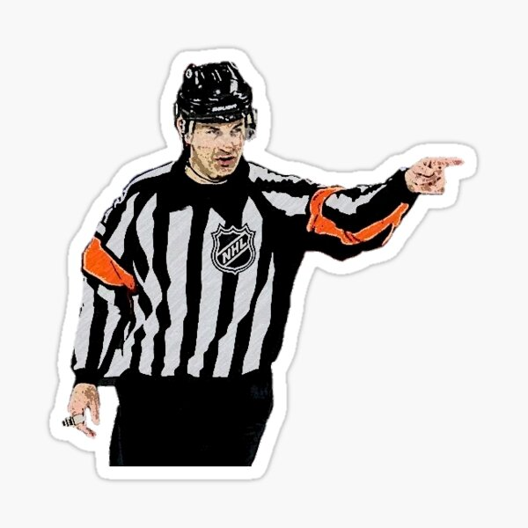
Special Guest
Brendon Stitt – D4 Referee-in-Chief
Penalty review
Process review

Slide 14

🕒 Game Switching vs. Game Rescheduling
🔁 Game Switching
Two visiting teams trade their games against the same home team
No rescheduling of ice required
Initiated by a visiting team – does not impact the home team’s schedule
Visiting teams must attempt a switch before requesting a reschedule

Slide 15
🕒 Game Switching vs. Game Rescheduling
📅 Game Rescheduling
A game cannot be played and must be rescheduled
Home team/association must provide a new ice slot
Impacts both home and visiting team schedules
Both changes must be approved in advance by your Statistician

Slide 16
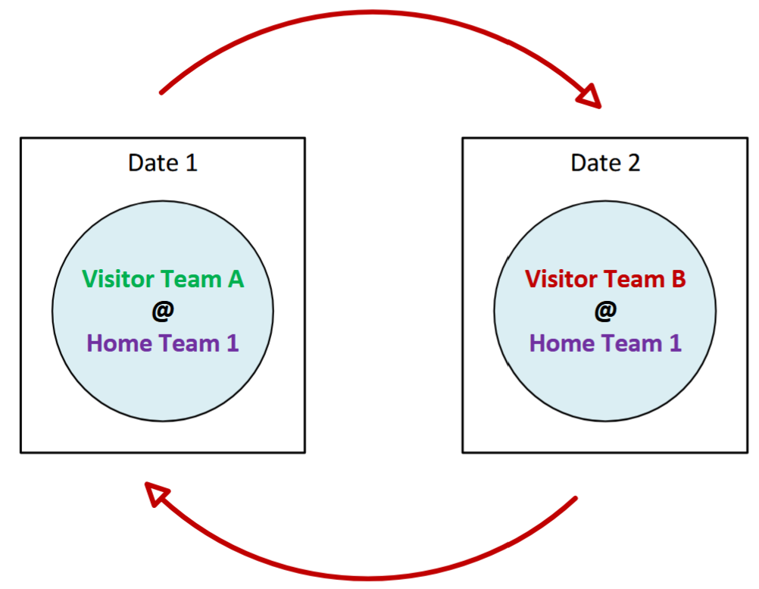


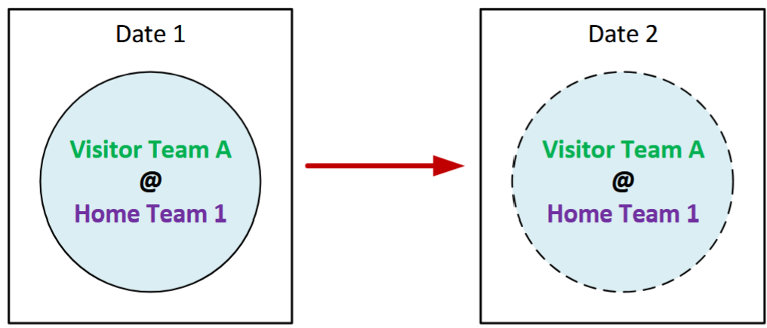
Game Switching and Rescheduling
Game Switch
Game Reschedule

Slide 17
🔄 Game Switch Process
Obtain prior consent from your Statistician
Gain agreement from the other visiting team
Complete the official Game Switch Form
Submit the form to the appropriate Statistician no later than 72 hours before the switched game
Statistician will:
  Update the online schedule
  Notify the home team
Home team cannot refuse to play the switched game(s)

Slide 18
Game Reschedule
Requesting teams must submit the request to their Statistician
Must complete the Game Reschedule Form
Statistician may approve or deny the request
Approval must be obtained before contacting another team
Exception: Reschedules due to inclement weather
Full details (and forms) are on the league website (For Teams menu)

Slide 19
🌨️ Inclement Weather Re-Scheduling
Team officials must contact their Statistician, who has the authority to postpone games due to weather conditions
If the Statistician cannot be reached, contact one of the following League Executives:
  League President
  Treasurer
  Secretary
The opposing team must be notified by the team official requesting the cancellation
The team official must then contact their Association’s Referee Scheduler to advise that:
  The game has been postponed
  It will be re-scheduled
⚠️ Important: Teams cannot postpone a game on their own.
Doing so may result in a fine or suspension.

Slide 20
Game Switch/Reschedule Notes
Deadline:
  Post December 15 – Maximum of 2 reschedule requests
  After December 31 – No additional changes
Invalid Reasons:
Team Activities
Player/coach absences
start time
Back-to-back games/days.
Referee costs charged to LCMHL will be borne by the team

Slide 21
⚖️ Game Protests & Appeals
Must be made to the League within 72 hours of relevant game
Must be in writing from the home association’s president or other designated official and addressed to the League President
Must clearly state the grounds upon which the appeal is being made and what aspect of the game, in particular, is being appealed.
The League will assess the appeal and determine whether or not it will be formally considered
Appeals of a frivolous or trivial nature will not be considered
Source: LCMHL Rules and Regulations

Slide 22
Game Sheets
Should be correctly completed and be legible
Must be entered into the league website
  Within 48 hrs (Regular Season)
  Within 24 hrs (Playoffs)
You must enter exactly what appears on the game sheet
No corrections or other changes
LCMHL may perform a full audit if violations are suspected
Teams are responsible for keeping game sheets for a year
If timekeeper is absent, the home team is responsible for timekeeping and game sheet completion

Slide 23
Penalty Minutes & Suspensions
Penalty Minutes
  Monitored monthly by the league
  For teams that receive 50% more penalty minutes than the division average
    The association and the team are notified
    Disciplinary action may follow if improvement is not shown
Suspensions
    The league has the right to add suspension games that are in addition to those specified in HEO’s Code of Discipline and by the district
    Ensure you carefully track games served and are diligent at updating TTM with them

Slide 24
Penalty Minutes U9 & U11
Penalty Minutes – U11 (Some confusion last year)
  Minor penalty = 2 minutes
  Double minor = 4 minutes
  Major penalty = 5 minutes (includes a game misconduct)
Penalty Minutes – U9 – Full-Ice (After January 15, 2026)
  Minor penalty = 1 minute
  Major penalty = 3 minutes (includes a game misconduct)

Slide 25
Reminder U9 Format (1/2 Ice)
  Regular Season
    Half Ice format
    4 v 4 hockey – continuous play
    No Scoring
    Three-minute warm-up and Two 23-minute periods
    Change ends between periods
    Each period begins with a face-off
      Only 2 faceoffs per game
    Continuous clock
    Buzzer every 90 seconds – Shift change
    Often 2 simultaneous half-ice games - Both games are synchronized
    Game sheets are required in case of major penalties
    Full ice games after Jan 15th

Slide 26
District Perspective
Special Guest: Amanda Waterfield – D4 Chair

Slide 27
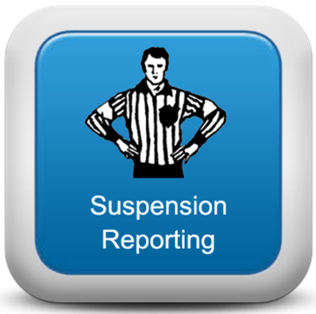
D4 Online Suspension Tracking System
Total Team Management (TTM)
Teams must report all suspendable offenses via TTM
Reporting must be done within 24 hrs. of each game
The system will indicate the default # of games your player or bench staff will need to serve.
Teams must report each game served
LCMHL will reconcile the carry over into each new season
Access
Team accounts are set up each season
The system is accessed from
  The LCMHL website (For Teams)
Users request their team password upon first-time access

Slide 28
Tournaments
Priority is always given to league games
Tournaments must be approved by the league
Procedure
  Obtain approval (Blackout dates) from the league statistician
  Complete the online Tournament Request Form
  Address conflicting league games via Switches and Reschedules
  Submit travel form for D4 Approval.
Caution
  See LCMHL Website for more information
  Note Blackout dates for the season
    Important Dates (Lanark Carleton Minor Hockey League) (lcmhl.ca)

Slide 29
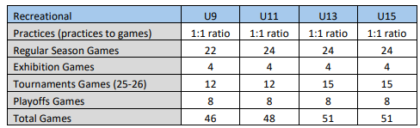
Tournaments
Notes
  Shows maximum number of games
  U9 (post Jan 15) full-ice = 7 of 22 games
  Travel permits are required for all tournaments signed by the District Chair.
  Effective for the 25-26 season, HEO allowed for one extra tournament (increase already reflected on chart) at every level (max of 5), two of which must be local tournaments for AA and below so long as teams maintain their respective levels of practice ratio. HEO reserves the right to do a spot check anytime during the season.

Slide 30
Escalation
Situations
  When you have concerns over a situation that you feel should be addressed
  You have a voice, but protocol must be followed
Escalation Procedure
    Wait 24 hrs. (“24 hour rule”)
    Contact Association (convener, director, president)
    Association President Contacts the League President
Please remind your parents!
  They should always start by approaching the head coach

Slide 31
LCMHL Website
SportsHeadz
  The primary means to administer the League’s hockey activities
  The definitive source for game schedules, announcements, etc.
  League’s responsibility
    Game Schedules
    Statistics Reporting
    League-wide Communication
  Team Responsibility
    Team Roster Maintenance ← Input your roster immediately
    Team Contacts (Bench Staff) Maintenance
    Reporting Game Results

Slide 32
GameCentral Account Provisioning
  A 2 Step Process
  Step 1
    Association convenors provide team contacts in an online spreadsheet
    League statisticians have the system email an invitation to a team contact
  Step 2
    Team contacts receives the invitation
    Follows a link to create an account
    Once created, team contact can log into the LCMHL website
    The account will be linked to all teams for which user was registered

Slide 33
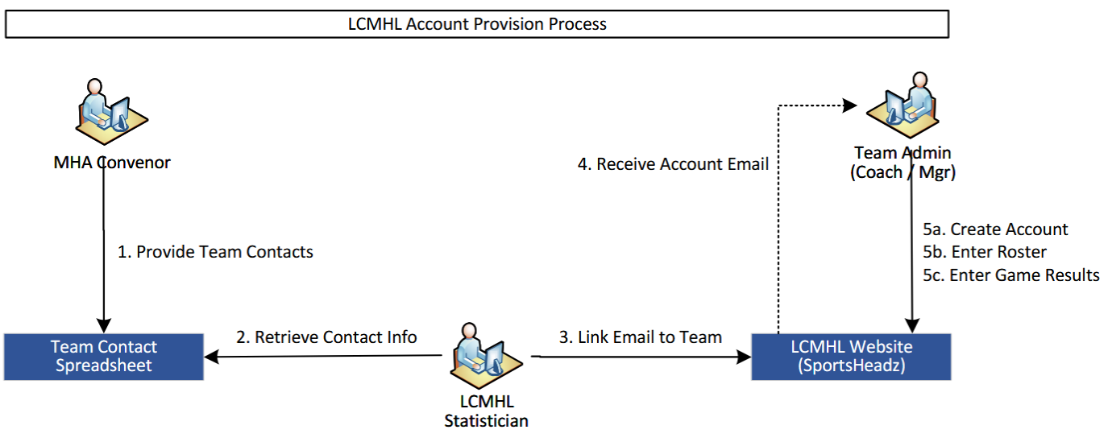
GameCentral Account

Slide 34
Website – Team Responsibility
Each must perform the following on the league website
  Enter team staff (contact) information
  Enter the team roster
  Enter game results
Additionally, they may:
  Create another team website user (aka Team Admin)
  This might be a backup manager, a parent who will enter game results, etc.

Slide 35
Reference Links
Affiliation Chart - House League Affiliation Chart (Lanark Carleton Minor Hockey League) (lcmhl.ca)
Game Switch and Reschedule forms - https://lcmhl.ca/Pages/1193/Game_Switches_and_Reschedules/
LCMHL Appeals - LCMHL Handbook -LCMHL Rules and Regulations, Section 15
Game Sheet Instruction - How to Fill Out a Gamesheet (Lanark Carleton Minor Hockey League) (lcmhl.ca)
Tournament Process - Tournament Requests (Lanark Carleton Minor Hockey League) (lcmhl.ca)

Slide 36
Reference Links
GameCentral Account: Obtaining a LCMHL Website Acoount (Lanark Carleton Minor Hockey League)

Slide 37
Contacts
Mike Taylor – President – president@lcmhl.ca
Fiona Livingstone – Treasurer – treasurer@lcmhl.ca
Brad MacDonald – Webmaster – web@lcmhl.ca
Statisticians
Shawna Kealey – U9 – U9@lcmhl.ca
Jordan Heavens – U11 – U11@lcmhl.ca
Jane Cameron – U13 – U13@lcmhl.ca
Marie Côté – U15 – U15@lcmhl.ca
Debbie Heuchert – U18 – U18@lcmhl.ca
Debbie Heuchert – U21 – U21@lcmhl.ca

Slide 38

Closing
Schedules
  All schedules have been posted to the website
  Please Remember: SCHEDULES ARE SUBJECT TO CHANGE.
  Always check with game times on the website (Assoc. or League)
Thank you again for volunteering!
Any comments or suggestions about the LCMHL (respectful) are welcome
Have a Safe and Fun Season

